Slide 1
ist 263
Accessibility

Slide 2
Agenda
Accessibility

Slide 3
What is Accessibility

Slide 4
A11y (Accessibility)
The Web is fundamentally designed to work for all people, whatever their hardware, software, language, location, or ability. When the Web meets this goal, it is accessible to people with a diverse range of hearing, movement, sight, and cognitive ability.
Thus the impact of disability is radically changed on the Web because the Web removes barriers to communication and interaction that many people face in the physical world. However, when web sites, applications, technologies, or tools are badly designed, they can create barriers that exclude people from using the Web.
- Tim Berners-Lee (Inventor of the Web)

Slide 5
Types of Disabilities
Permanent
Blind
Missing Arm
Deaf
Color Blindness
Older Folks With Reading Glasses
Temporary
Cataract
Broken Wrist
Situational
New Baby
Distracted Driver
Accessibility is for everyone!

Slide 6
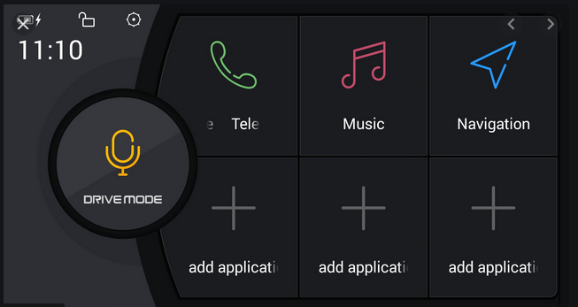
Example Non-Traditional Accessibility
Android Drive Mode

Slide 7
Accessibility Laws
United States – Section 508
Canada – any company with more than 50 employees should have an accessible website.

Slide 8

Accessibility Lawsuits
https://www.cnbc.com/2019/10/07/dominos-supreme-court.html

Slide 9
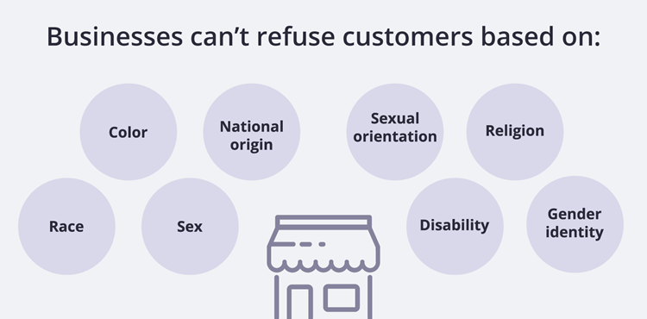

Slide 10
Making your site look good on:
Tab order
Alt attribute
Video subtitles
Semantic tags
Color contrast
Resizable text

Slide 11
Screen Reader demo

Slide 12
https://www.youtube.com/watch?v=q_ATY9gimOM

Slide 13
How To make site Accessible

Slide 14
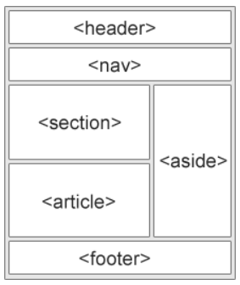
Semantic Tags
Make sure you are using the semantic tags properly. Folks with screen readers are going to hear the names of your semantic elements.
For example – don't use an article tag for an element that is not an article.
Make sure you use header, footer, main, etc. semantic elements.

Slide 15
Headings
Respect the H1 – H6 tags
You should only have 1 H1 tag on the page as the main heading
Use the other heading tags in order as subheadings (h2), sub-subheadings (h3), etc.

Slide 16
Alt Attribute for img element
Describe your image
Don't say image of sunset, just say sunset
If the image is purely decorative, not content, use and alt tag but leave it blank – screen readers skip over this.

Slide 17

Alt Text: What text describes this image?

Slide 18

Alt Text: What text describes this image?

Slide 19

Color Contrast
This is for people who are color blind and can also help older folks and people with visual impairments.
Contrast Checker: https://webaim.org/resources/contrastchecker/

Slide 20
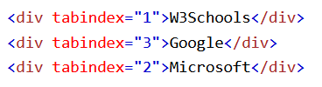
Tab Index
Manually order the elements on your page

Slide 21
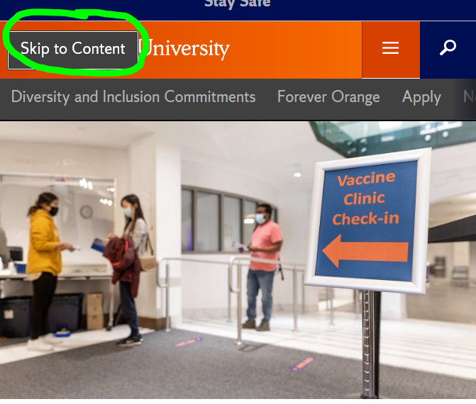
Skip to Content Button
https://www.w3schools.com/accessibility/accessibility_skip_links.php

Slide 22
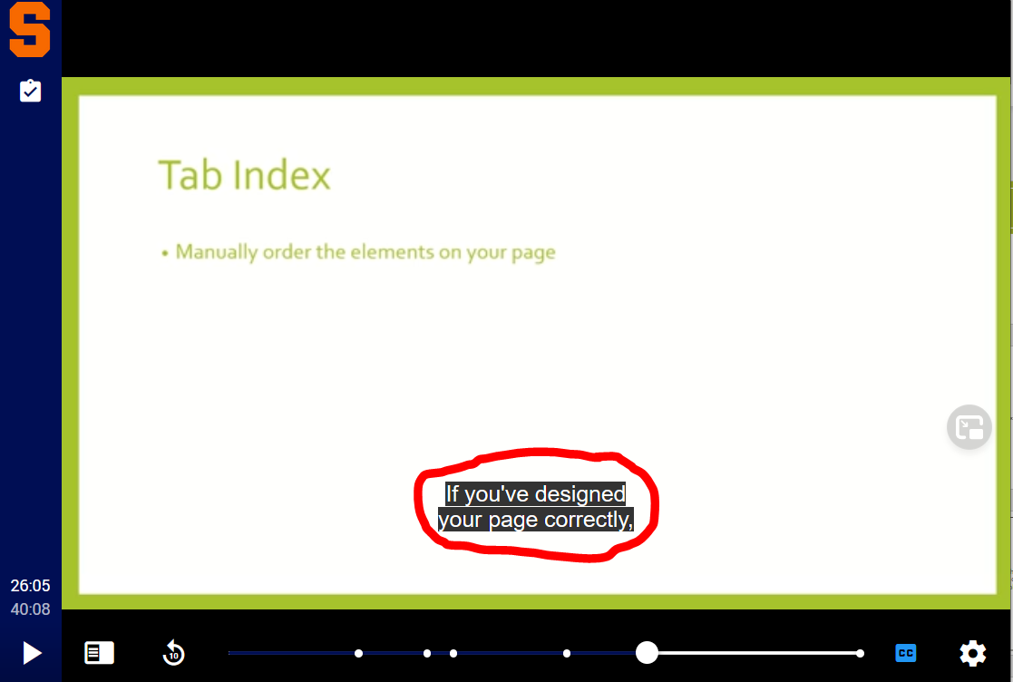
Video Captions
Help with SEO because of searchable text.

Slide 23
Accessibility tools

Slide 24
WAVE – Browser extension for Chrome, Firefox, Opera
A11ytools – Browser extension for Safari
Chrome Dev Tools – Audits https://dev.to/josefine/accessibility-testing-with-chrome-devtools-2bl4
Lighthouse
aXe
A11Y Project
Jaws Screen Reader

Slide 25
WAVE Demo

